Slide 1

Emotional State TransferS
Shailesh Dargude
2020

Slide 2
Problem Statement
On a Social networking platforms, Can the emotional states be transferred to others via emotional contagion, leading them to experience the same emotions as those around them.?
The project is based on a paper published by Adam D. I. Kramer, Jamie E. Guillory, and Jeffrey T. Hancoc in 2014.

Slide 3


Decluttering the Problem
For a given user on social networking
platform , if user’s timeline has posts with extreme emotions, will it have any affect on the user’s next post or activity on the platform?.
User
Friend A
Friend B
Friend C
Friend D
Friend E
Friend F

Slide 4
High Level Algorithm
This project uses a micro blogging platform, Twitter in attempt to detect the contagion effect.
A friend list of a given users is fetched using Twitter APIs.
For each friend fetch tweets like, created and detect the emotion of the tweet using custom built model.
Reconcile emotions from multiple friends and find overall emotion of timeline.
Predict if user may tweet negative or positive emotion post.

Slide 5
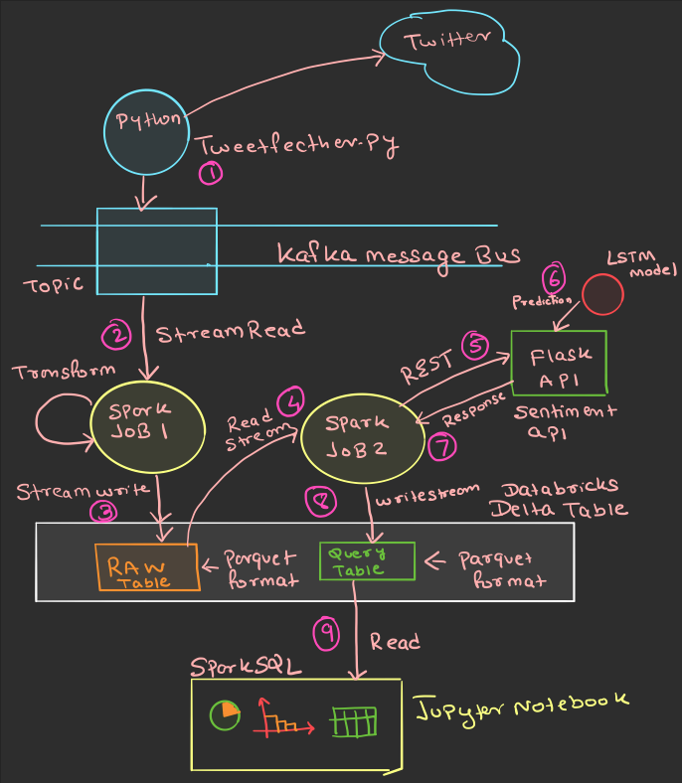
High Level System Design

Slide 6
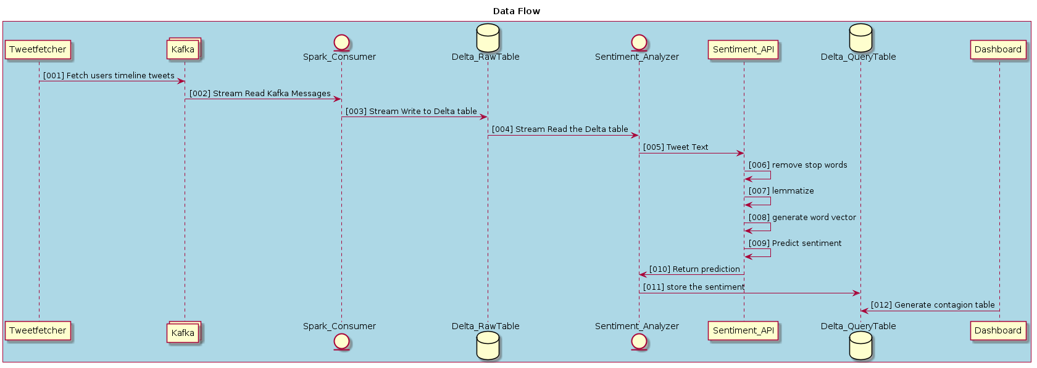
Information Flow

Slide 7
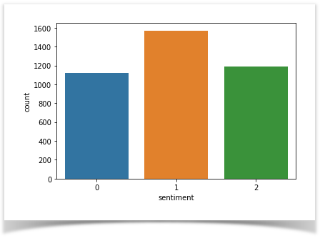
dataset
A Twitter dataset with 140 characters tweets having labels Neutral(1), Positive(2) and Negative(0)

Slide 8
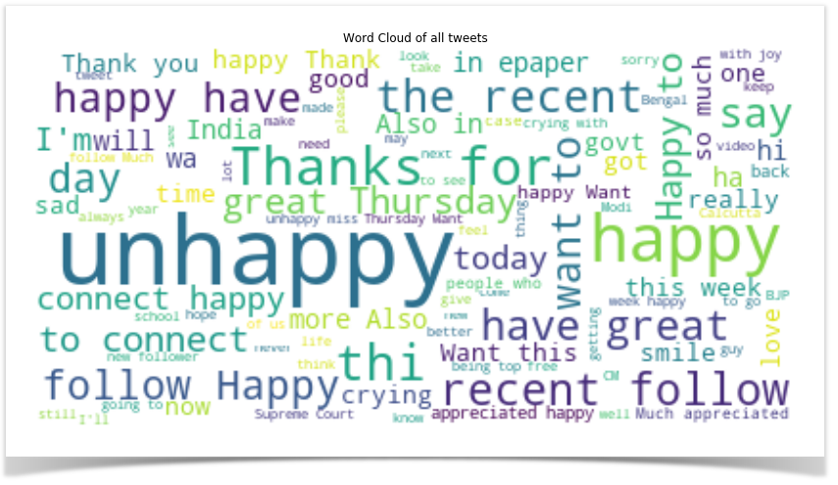
Data Exploration
Top words in the tweet

Slide 9
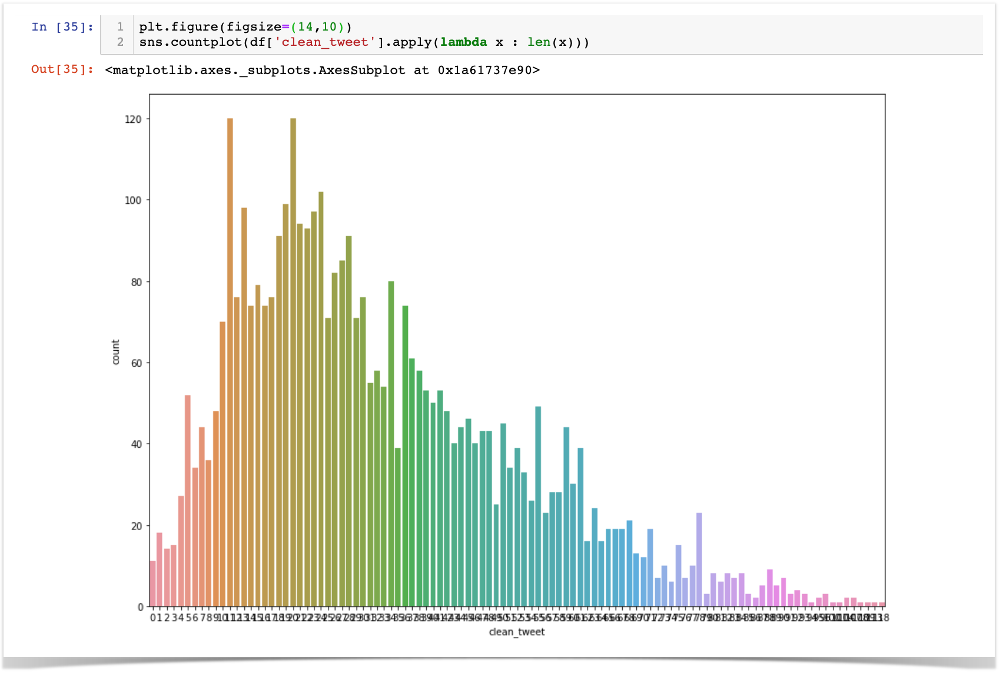
Data Exploration
Average Length of Tweet

Slide 10
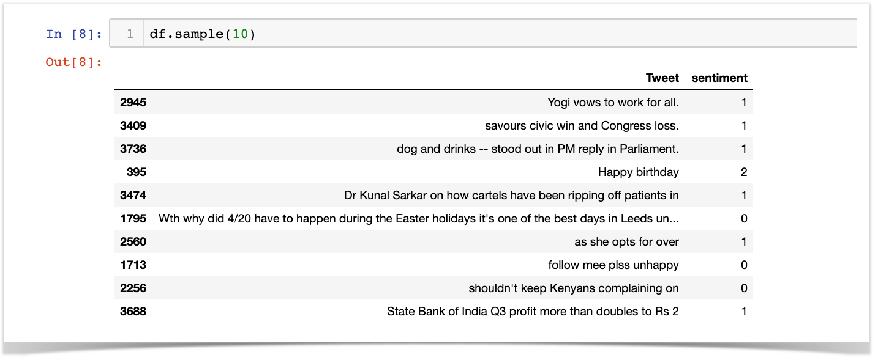
Data Exploration
Sample data

Slide 11
Data Transformation Steps
Remove Punctuations
Remove Numbers
Tokenize
Remove stop words.
Perform Stemming.
Perform Lemmatizing.
Transform to word vector.

Slide 12
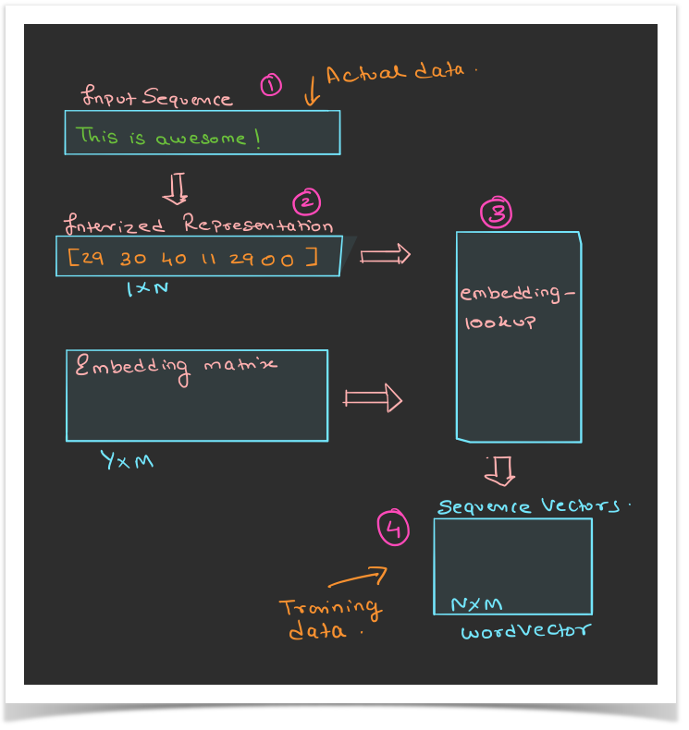
Word Embedding
Most popular representation of document vocabulary, which is capable of capturing context of a word in a document, semantic and syntactical similarities.

Slide 13
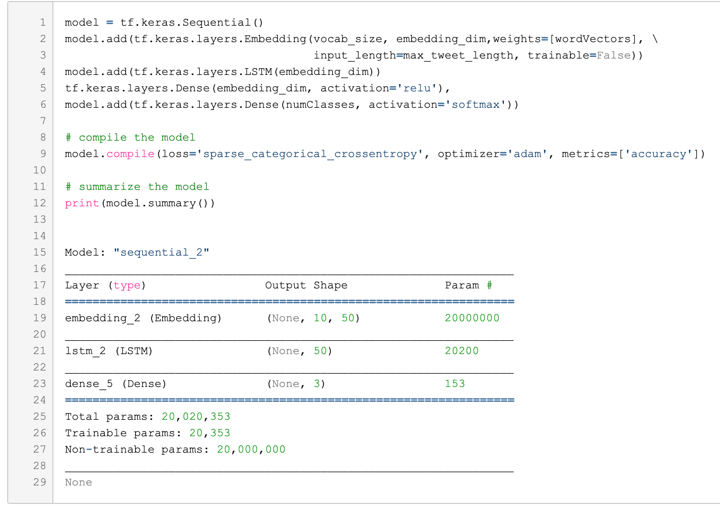
LSTM model using Tensor flow 2.0
TensorFlow 2.0 sequential API with following layers
Input Layer
Embedding Layer
LSTM layer
Dense output layer
$

Slide 14
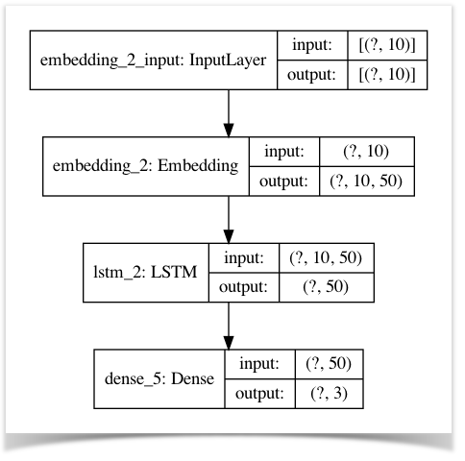
LSTM modeL

Slide 15
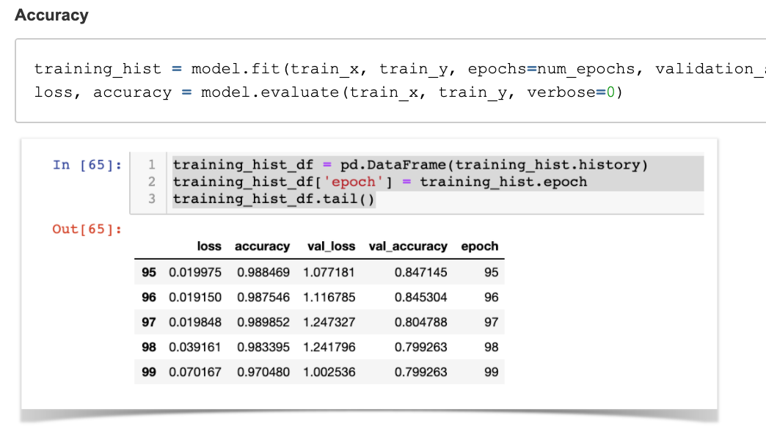
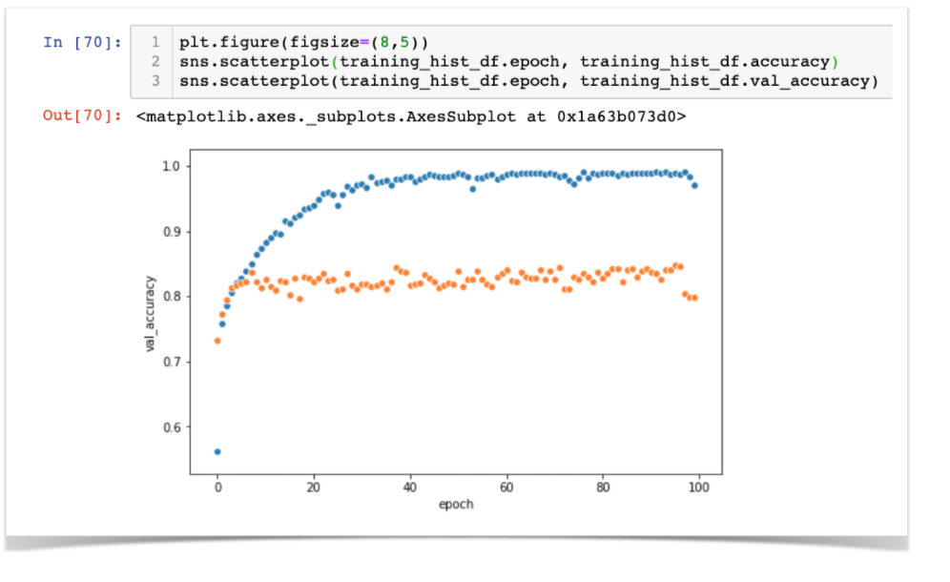
Evaluating Model

Slide 16
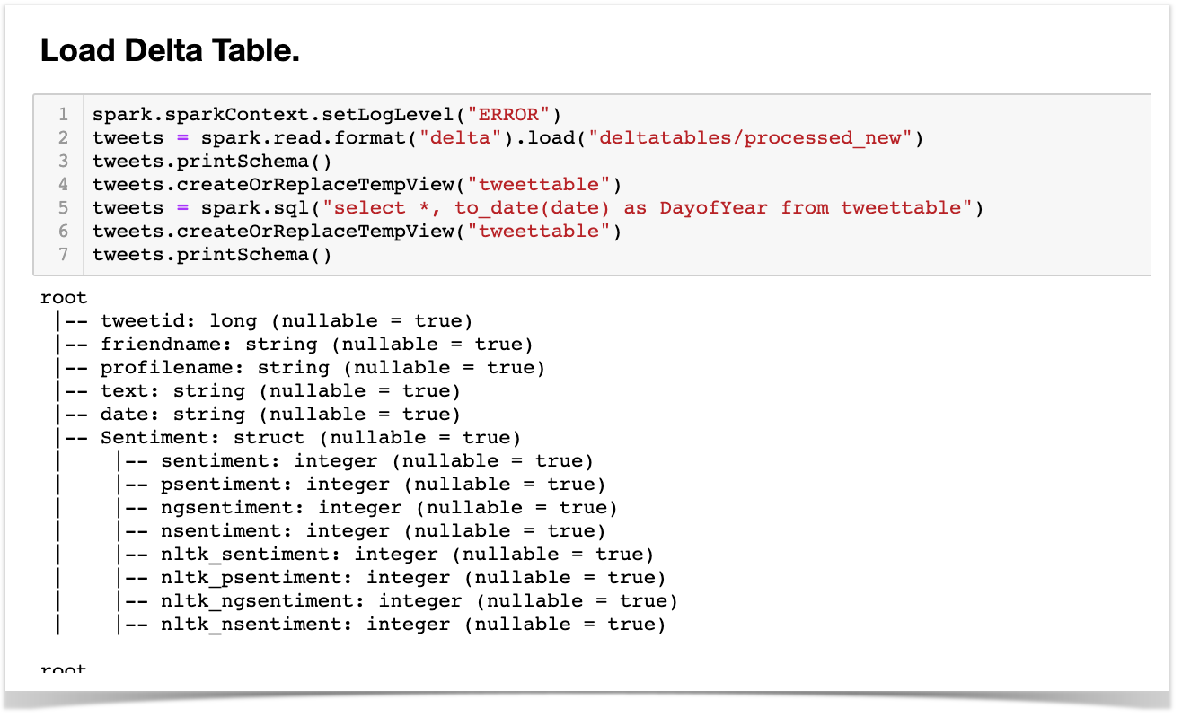
Transforming the DATA
RAW DELTA TABLE

Slide 17
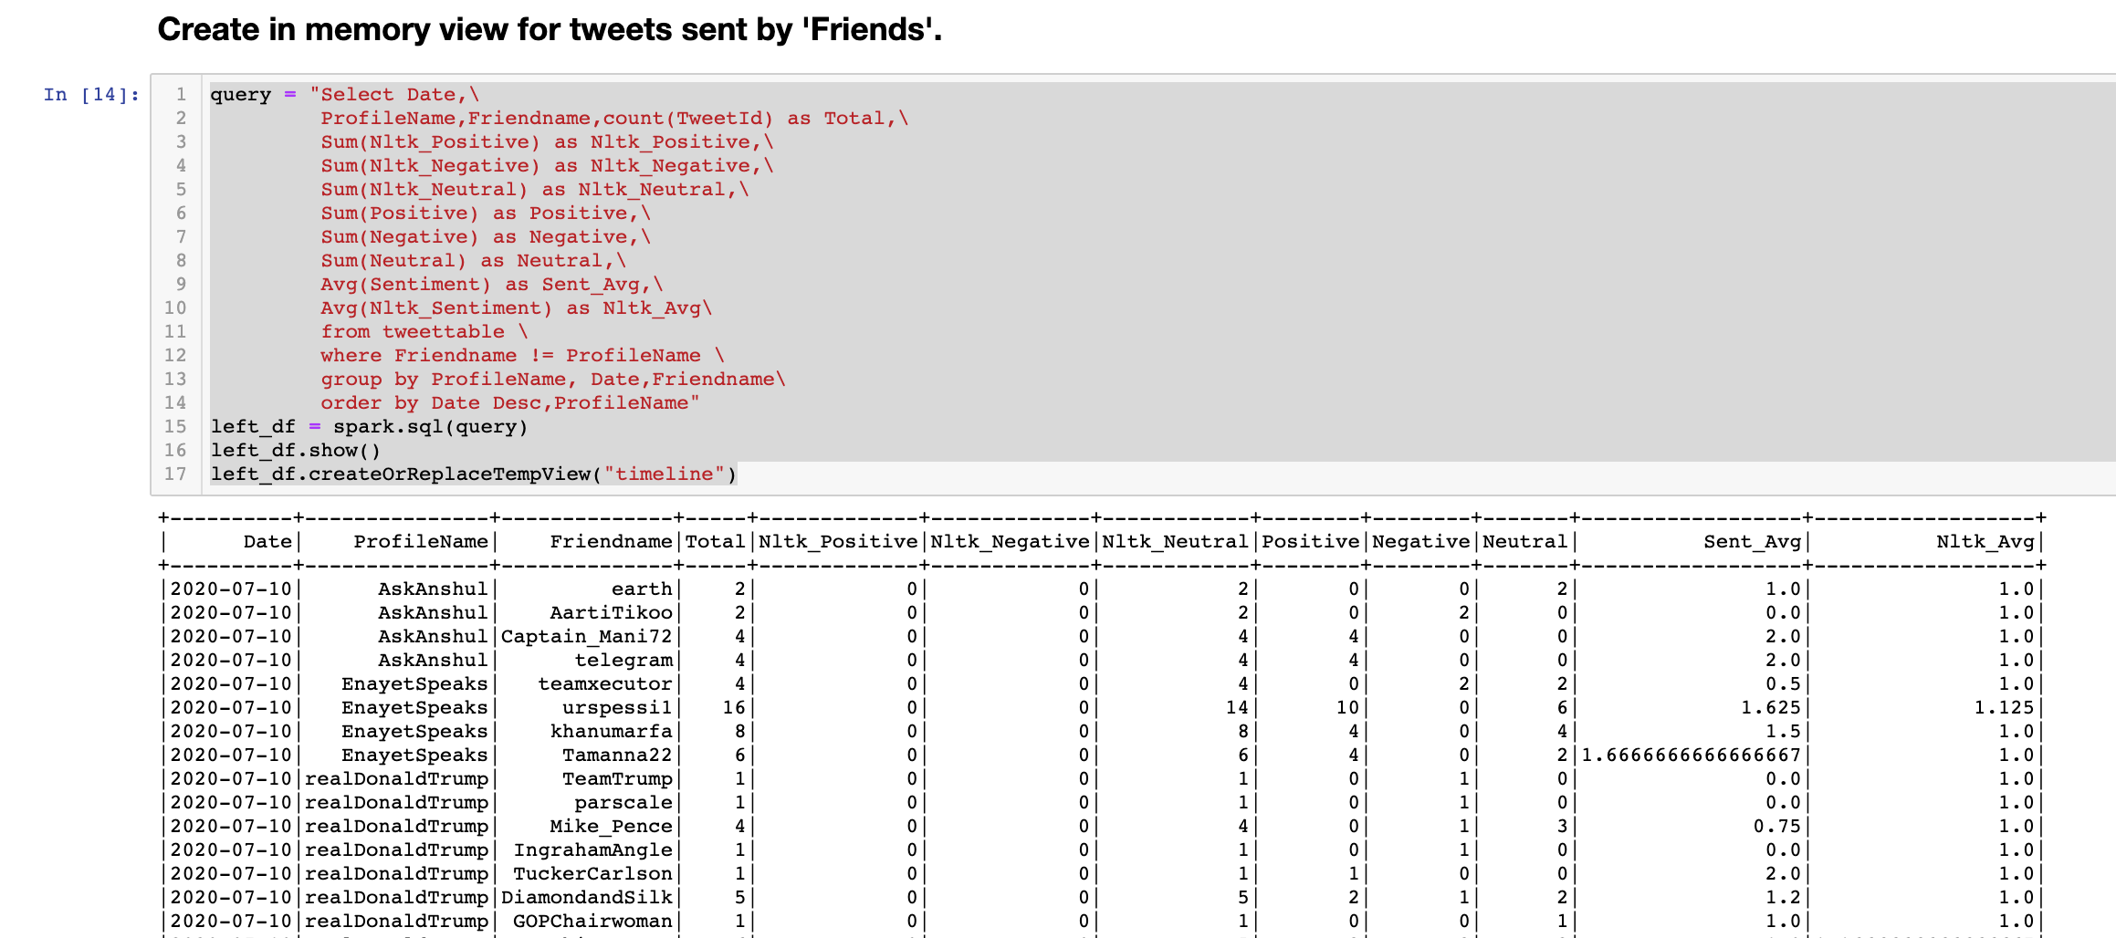
Transforming the DATA
Flatten the Raw Table

Slide 18
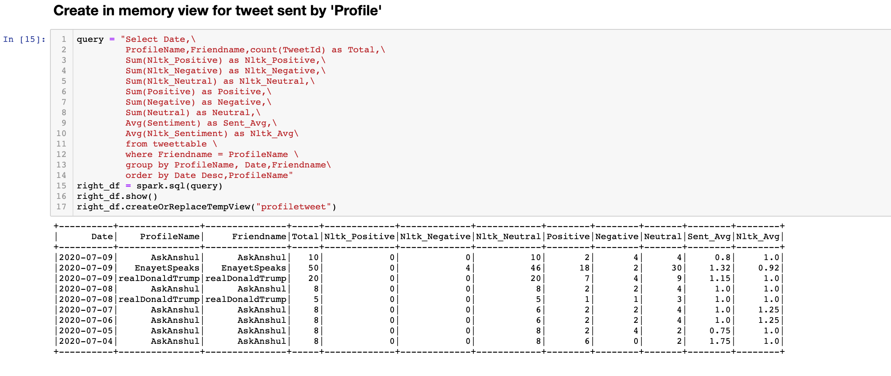
Transforming the DATA
Aggregate tweets by each User

Slide 19
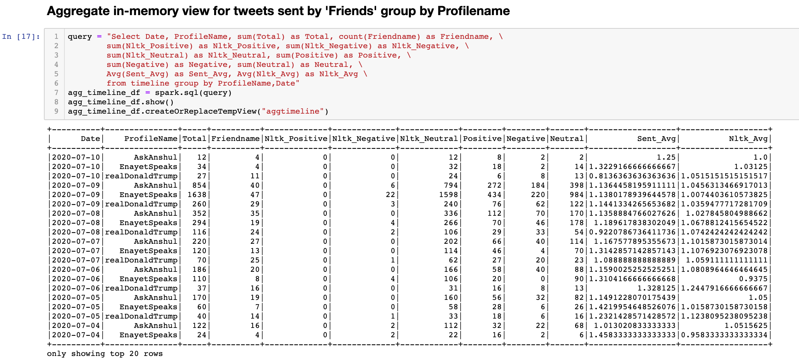
Transforming DaTA
Aggregate tweets sent by friends

Slide 20
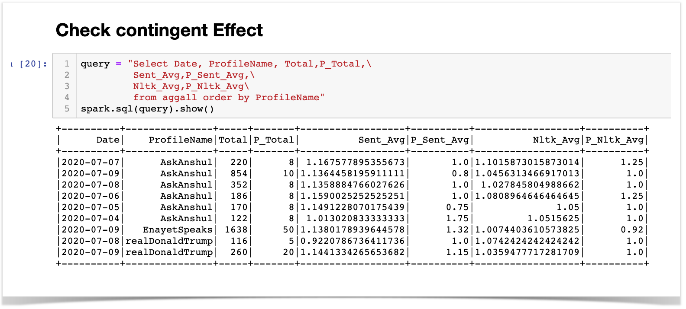
Final Results
Contingent Effect
ProfileName: User of our interest.
Total : Total tweets on user's timeline on a particular date.
P_Total. : Total tweets sent by user on a particular date.
Sent_Avg. : Average Sentiment on tweets on user's timeline, as computed/predicted by custom LSTM model.
P_Sent_Avg: Average sentiment of tweets sent by user, as computed/predicted by custom LSTM model.
Nltk_Avg. : Average Sentiment on tweets on user's timeline, as computed/predicted by nltk.
P_Nltk_Avg : Average sentiment of tweets sent by user, as computed/predicted by nltk.

Slide 21
Conclusion
As we see from the inference from the small data set used in the experiment, emotions can spread throughout a network i.e. difference between Sent_Avg, P_Sent_Avg).
We can see that there exist some correlation between User's timeline and tweets sent by the user.
Online messages influence our experience of emotions, which may affect a variety of offline behaviors.

Slide 22
Acknowledgements
Special Thanks to my mentor Nathan Sutton for all the help and advice whenever required.
Reference:
https://www.pnas.org/content/111/24/8788
https://nlp.stanford.edu/projects/glove/
https://www.kaggle.com/kazanova/sentiment140
https://www.oreilly.com/content/perform-sentiment-analysis-with-lstms-using-tensorflow/

